Slide 1
Story plan • Afforestation and carbon credit plantations. How can we assess resilience in the context of increasing disturbance frequencies but also increasing resources (CO2)? • In 3 different biomes, what level of increase in disturbance rate would lead to the replacement of a forest? And how would higher [CO2] ameliorate disturbance competition? • This is the first time an ensemble of demography models has been evaluated against observations. They allow us to explicitly capture the process of growth after planting and of mortality. • We show how key climate-related forest variables change over the course of regrowth (Biomass, roughness, albedo) (for diagnostic purposes also woody productivity and mortality?) • We evaluate biomass against regrowth data and old-growth data for 3 regions (sites). • We examine whether the models capture well known aspects of stand size structure (self-thinning) • We test whether the change in disturbance rates alter the balance / coexistence of PFTs (= lead to another kind of forest). • Implications.

Slide 2
EGU abstract
Forests in Dynamic Global Vegetation Models (DGVMs) have historically been simulated as area-averaged plant functional types in each gridcell instead of representing communities of trees of different sizes and ages (demography). Just as the behaviour of a tree differs according to its ontogeny, so the behaviour of forests is known to differ depending on their demography. Accurately simulating demography is therefore key in order to address questions on afforestation and management strategies, as well as assessments of resilience of forests to disturbances such as drought and fire or diversity changes after a disturbance. Ultimately, demography determines the overall forest biomass in natural forests and is a key arbiter of growth and mortality rates. DGVMs are now able to simulate size and age structure of the trees in forests. However, these models have so far not been benchmarked alongside each other. We evaluate 6 DGVMs (BiomeE, CABLE-POP, FATES, LPJ-GUESS, JULES-RED, ORCHIDEE) against observations on regrowth dynamics as well as natural forests at boreal, temperate and tropical sites. We examine whether the models capture observed regrowth dynamics after disturbance, well-known stand size structure and well-established processes such as self-thinning. We outline the planned route forward towards a standardised international benchmarking framework for demographic DGVMs.

Slide 3
Can we model forest demography globally? Benchmarking of state-of-the-art Demographic DGVMs
Annemarie Eckes-Shephard¹, Arthur Argles², Bogdan Brzeziecki³, Peter Cox⁴, Martin G. De Kauwe⁵, Adriane Esquivel Muelbert⁶, Rosie A. Fisher⁷, Jürgen Knauer⁸, Charles D. Koven⁹, Aleksi Lehtonen¹⁰, Marcos Longo⁹, Sebastiaan Luyssaert¹¹, Laura Marqués^{12,13}, Jon Moore⁴, Jessica F. Needham⁹, Stefan Olin¹, Mikko Peltoniemi¹⁰, Steven Sitch¹⁴, Benjamin Stocker^{12,13}, Ensheng Weng¹⁵, Daniel Zuleta¹⁶, and Thomas Pugh^{1,6}
Notes:
(8 min + 2 min for questions and discussions)

Slide 4
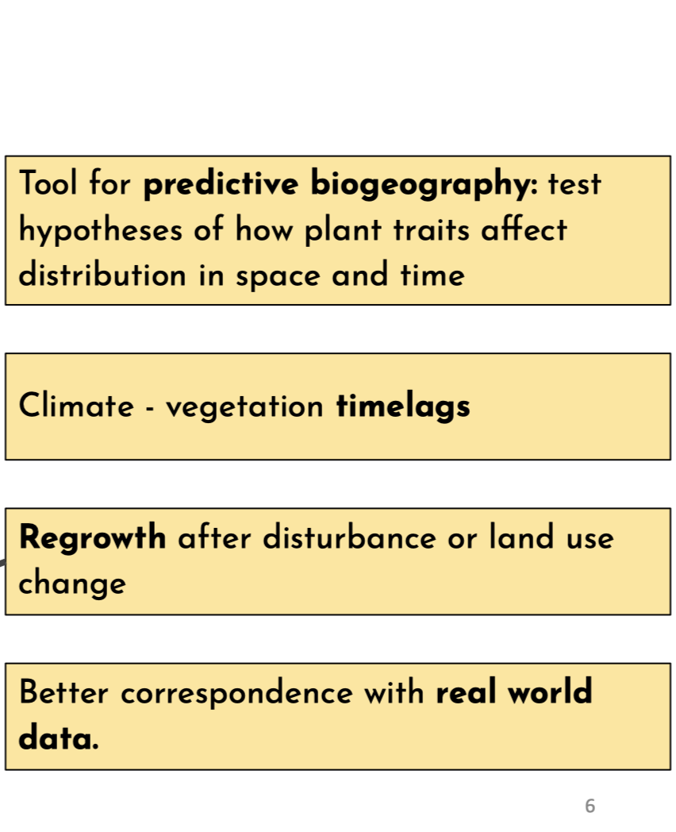
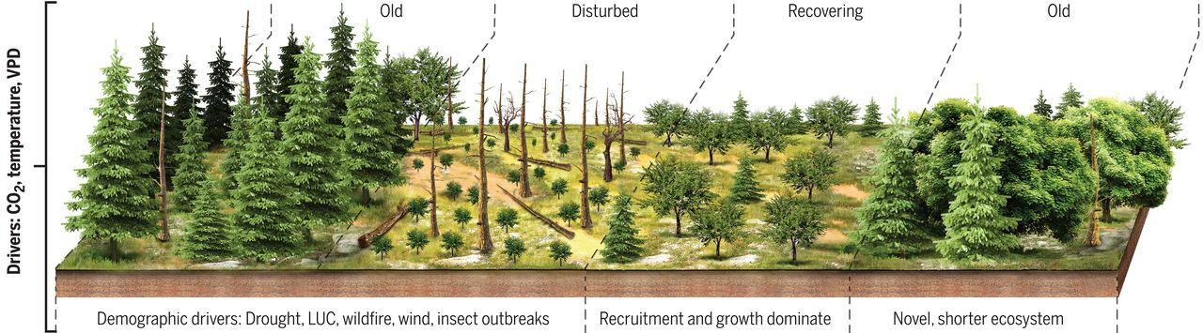
Representing forest demography matters for predicting future forest dynamics and properties
Credit: Rosie Fisher
Fig: McDowell et al., 2020. Science
Notes:
Component in Land surface modelling,
with feedback to the climate..
This is relevant for more realistically representing ->
Increased disturbances
Management
But for this, we need to find out whether Demographic vegetation models 1) do equally wel or better at replicating net biome exchange and other carbon balance variables 2) perform well against data for which they are developed 3) then can provide useful additional information that current LSM big leaf approaches cannot. And on the way towards this, we have created this benchmarking study, which I will present preliminary results of.

Slide 5
Introduce the models?
BiomeES, BiomeEP CABLE-POP, FATES, LPJ-GUESS, JULES-RED, ORCHIDEE
@ROSIE FISHER?
Notes:
More models joined – we are now 7 models in the intercomparison study.

Slide 6








B
Simulation setup:
How good are our models?
benchmark selection
Boreal
Time to recovery
NE, BIS, INE, Grass
Stand structure
Temperate
Dynamic equilibrium
carbon content
Aboveground woody
carbon (KgC m²)
NE, BS, BIS, Grass
Tropics
0
100
400
Years after disturbance
TrBE, TrIBE, TrBR,
Grass
Notes:
Here goes a Global map, with the three sites, and also in smaller dots the sites where the regrowth chronosequence data was from
Plot chronosequence data
Use as basis for introducing the run setups

Slide 7
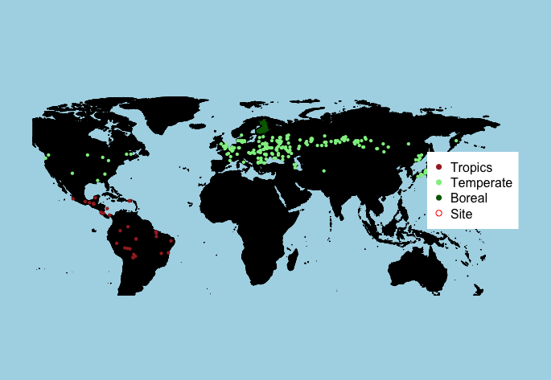
Observations
Teobaldelli et al., 2006 Forest Ecology and Management; Poorter et al., 2016 Nature; Tomppo et al., 2011. National ForestInventory of Finland

Slide 8
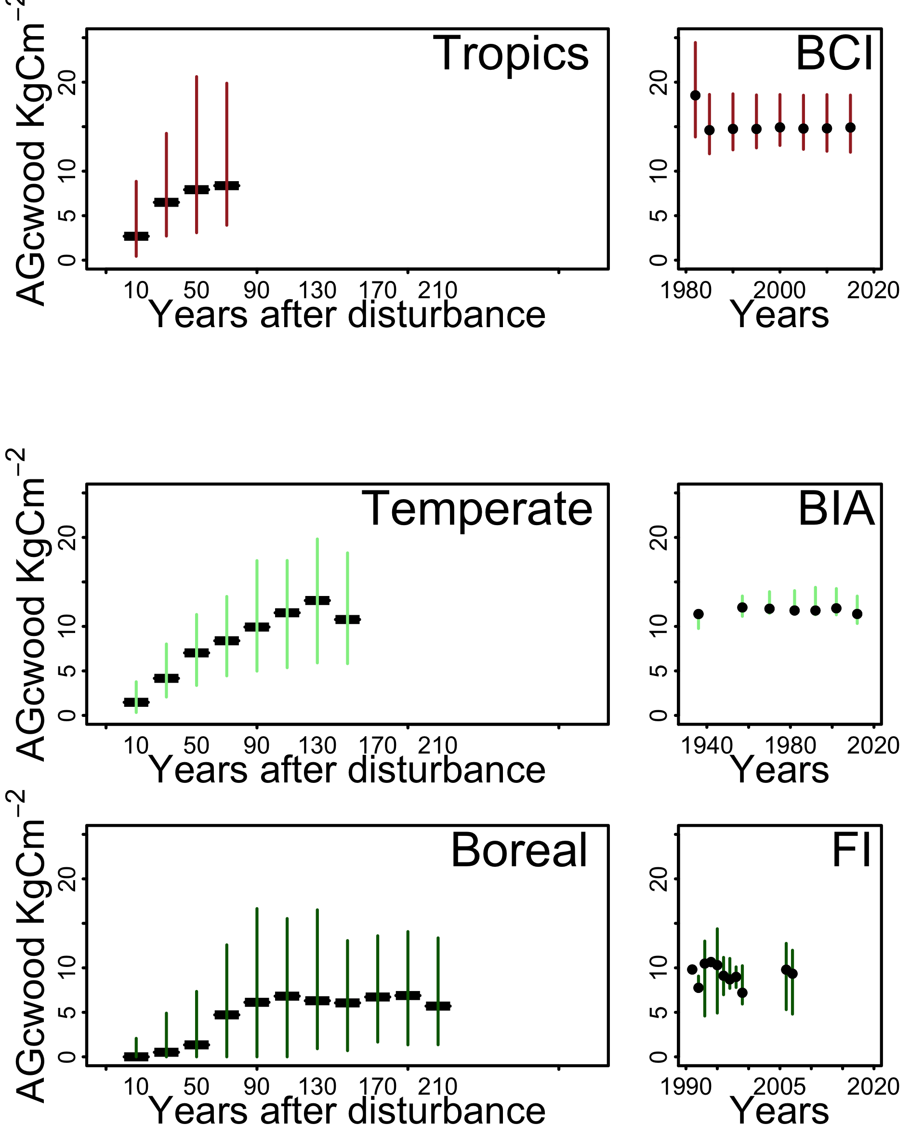
Observations

Slide 9
Peltoniemi et al., 2011, For Ecol & Mgmt, Condit et al.2019, Dryad;
Brziezki et al., 2016 . J Veg Science
Observations

Slide 10

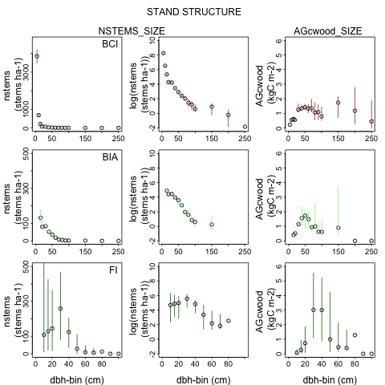
Stand structure observations: number of stems and carbon content per dbh-size class
Barro Colorado
Island
<10
51-60
151 -200
dbh-class
dbh-class
dbh = diameter at breastheight
Notes:
471.2389 cm large
Show number of stems unlogged, then say why log is important here, and announce the rest of the obsrvations are just logged stem numbers.
#Make people understand nstems and carbon content:
Many small trees,little carbon
some large trees – lots of carbon
FI = Picea abies (shade tolerant), Pinus sylvestris(shade intolerant) ,Betula pendula (shade intolerant)
# Picea abies, Tilia cordata, Carpinus betulus
#Species are a mix of intermediate shade tolerante, shade tolerant, shade-intolerant broadleaf summergreens and Picea abies (shade tolerant)
# decision to simulate:
#Shade tolerand broadleaf summergreen
#Shade intolerant broadleaf summergreen
#Shade tolerant needleleaf
Tropical shade tolderant Evergreen
Tropicsl Raingreen
Tropical shade intlderant evergreen.

Slide 11

Stand structure observations
Spruce, pine, birch
Spruce, Linden,
Hornbeam
Notes:
This slide is just to show how this works for all sites – too busy to go into detail. I just flash it up. - necessary at all?

Slide 12
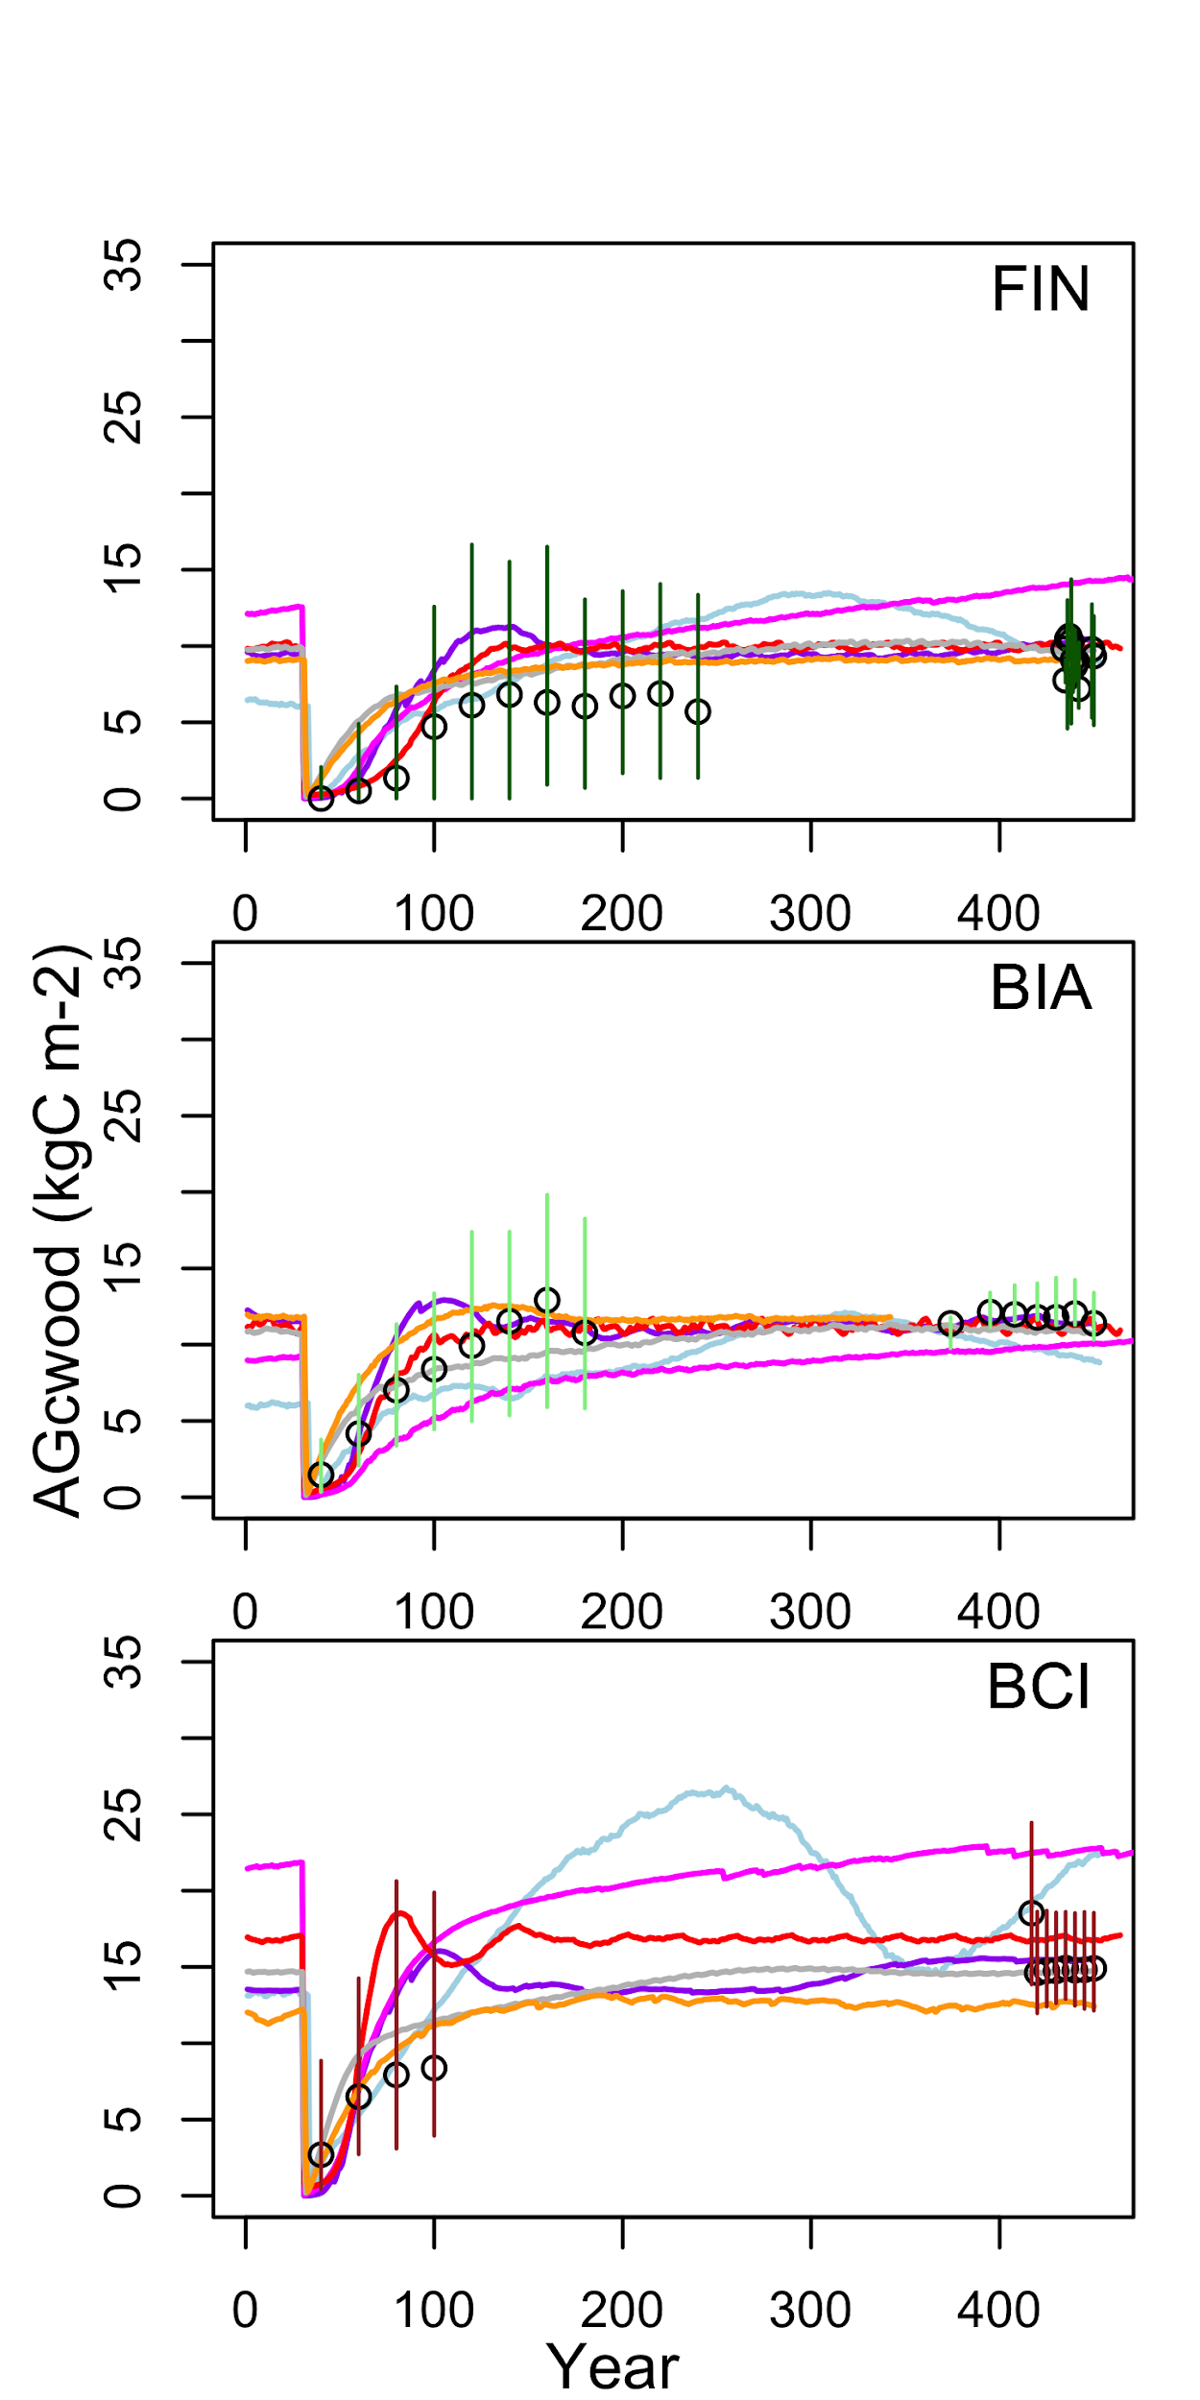
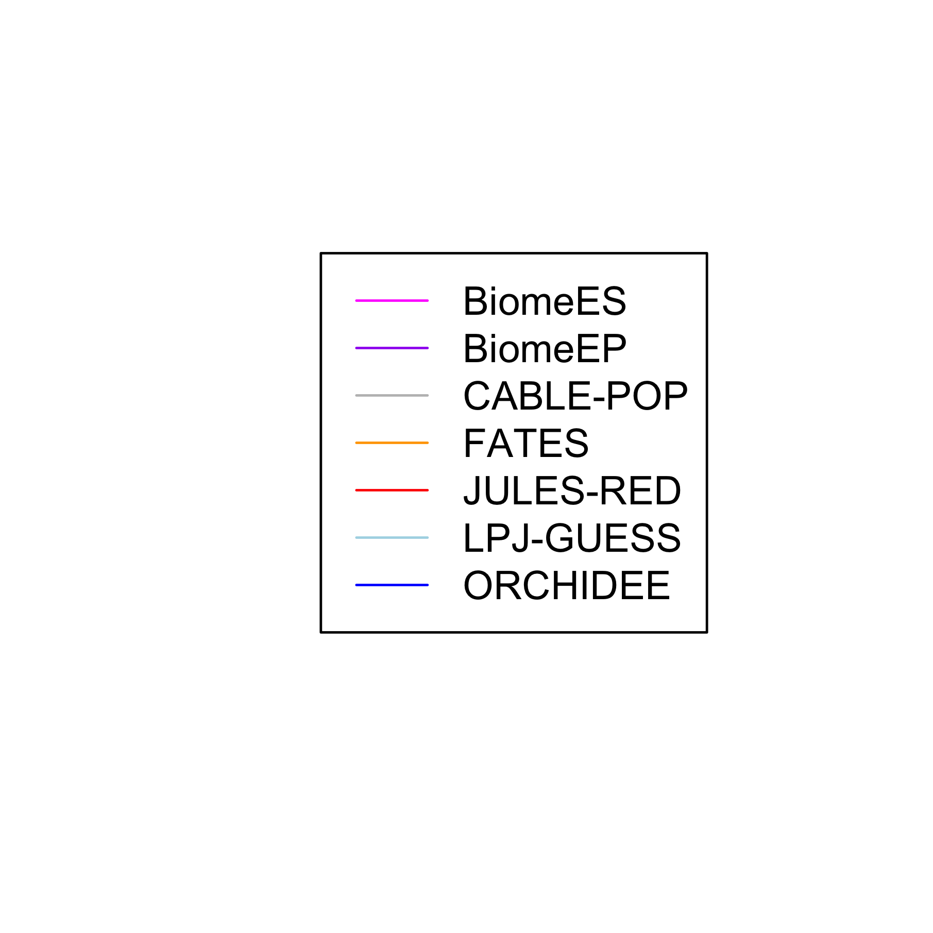
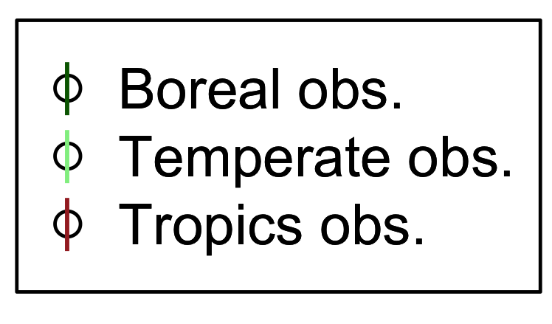
Regrowth after disturbance and equilibrium carbon content are replicated by the models
Teobaldelli et al., 2006 For Ecol & Mgm;
Poorter et al., 2016 Nature;
Tomppo et al., 2011. Nat. For Invent. of Finland
Notes:
Time to recovery within the range of the observations, slight overestimation in recovery time for BCI – maybe?
Equilibrium carbon content within the range of the observations for most models.
Different model-specific dynamics going on , which have to be disentangled, for example, some peak, then decline for BiomeEP at all sites and for JULES-RED in the tropics.
Large amplitudes in the tropics for LPJ-GUESS show the old trees dying off, and new smaller trees gaining in size after that.

Slide 13
The evolution of carbon content in different tree size-classes during regrowth.
LPJ-GUESS Finish site
Notes:
We use the last value of the regrowth simulations, to compare against stand structure observations, of the sites which we assume are in dynamic equilibrium.

Slide 14
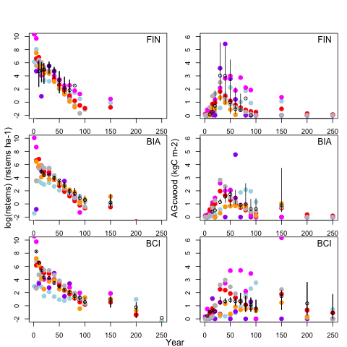
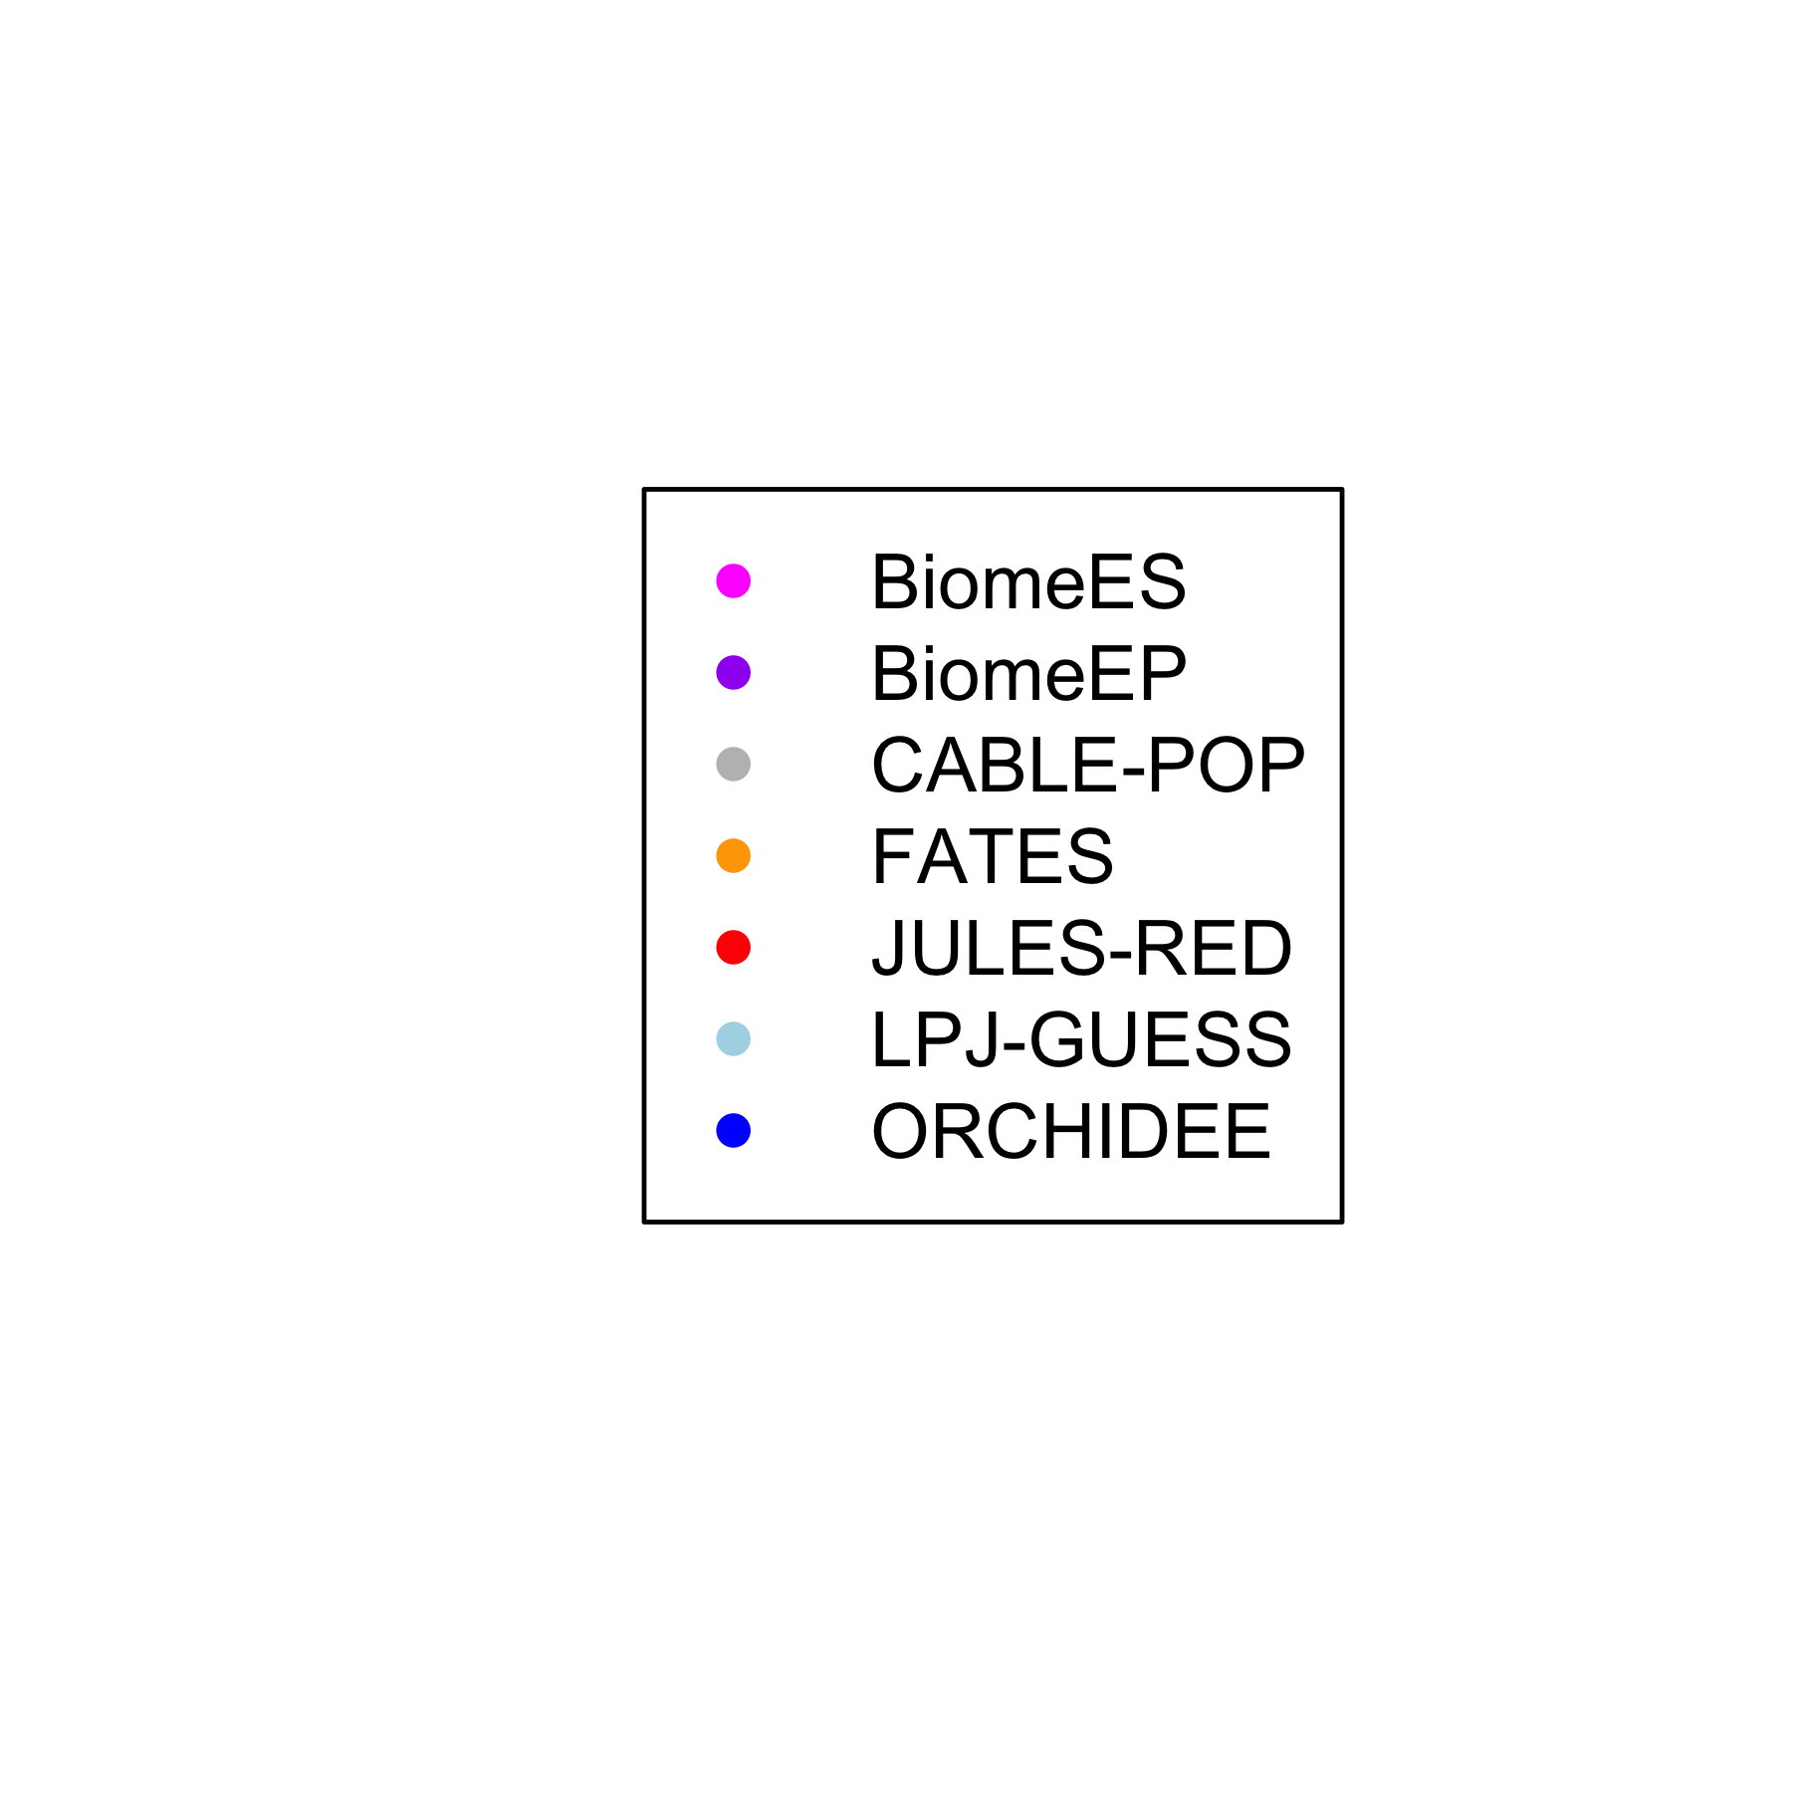
Models replicate stem number and carbon content per size class reasonably well.
<10
51-60
151 -200
dbh-class
Peltoniemi et al., 2011, For Ecol & Mgmt,
Condit et al.2019, Dryad;
Brziezki et al., 2016 . J Veg Science
dbh-sizeclass
Notes:
Overestimation of young size classes in the tropics.
Overestimation of older size classes at boreal site – this could be a data problem and not a model problem, because the data is not necessarily from old growth, but just from long-term unmanaged sites.

Slide 15
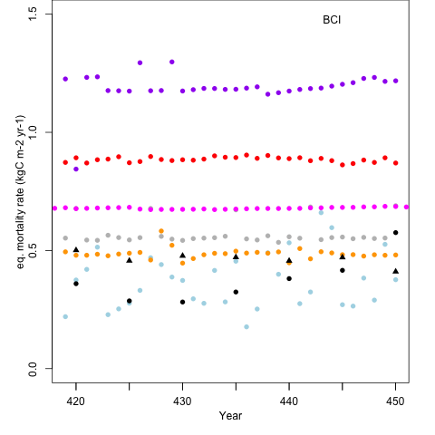
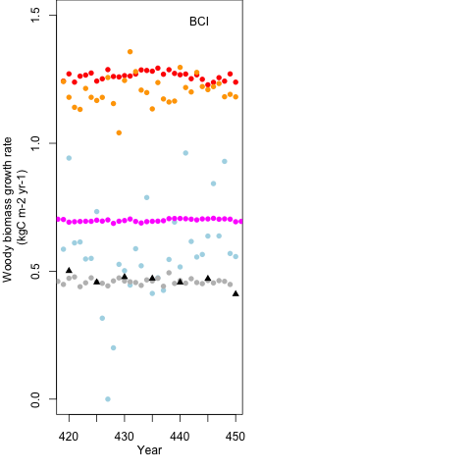
Do the models achieve these dynamics for the right reasons?
+ woody carbon (growth)
Dynamic equilibrium
carbon content
Aboveground woody
carbon (KgC m²)
- woody carbon (mortality)
0
100
400
Years after disturbance

Slide 16
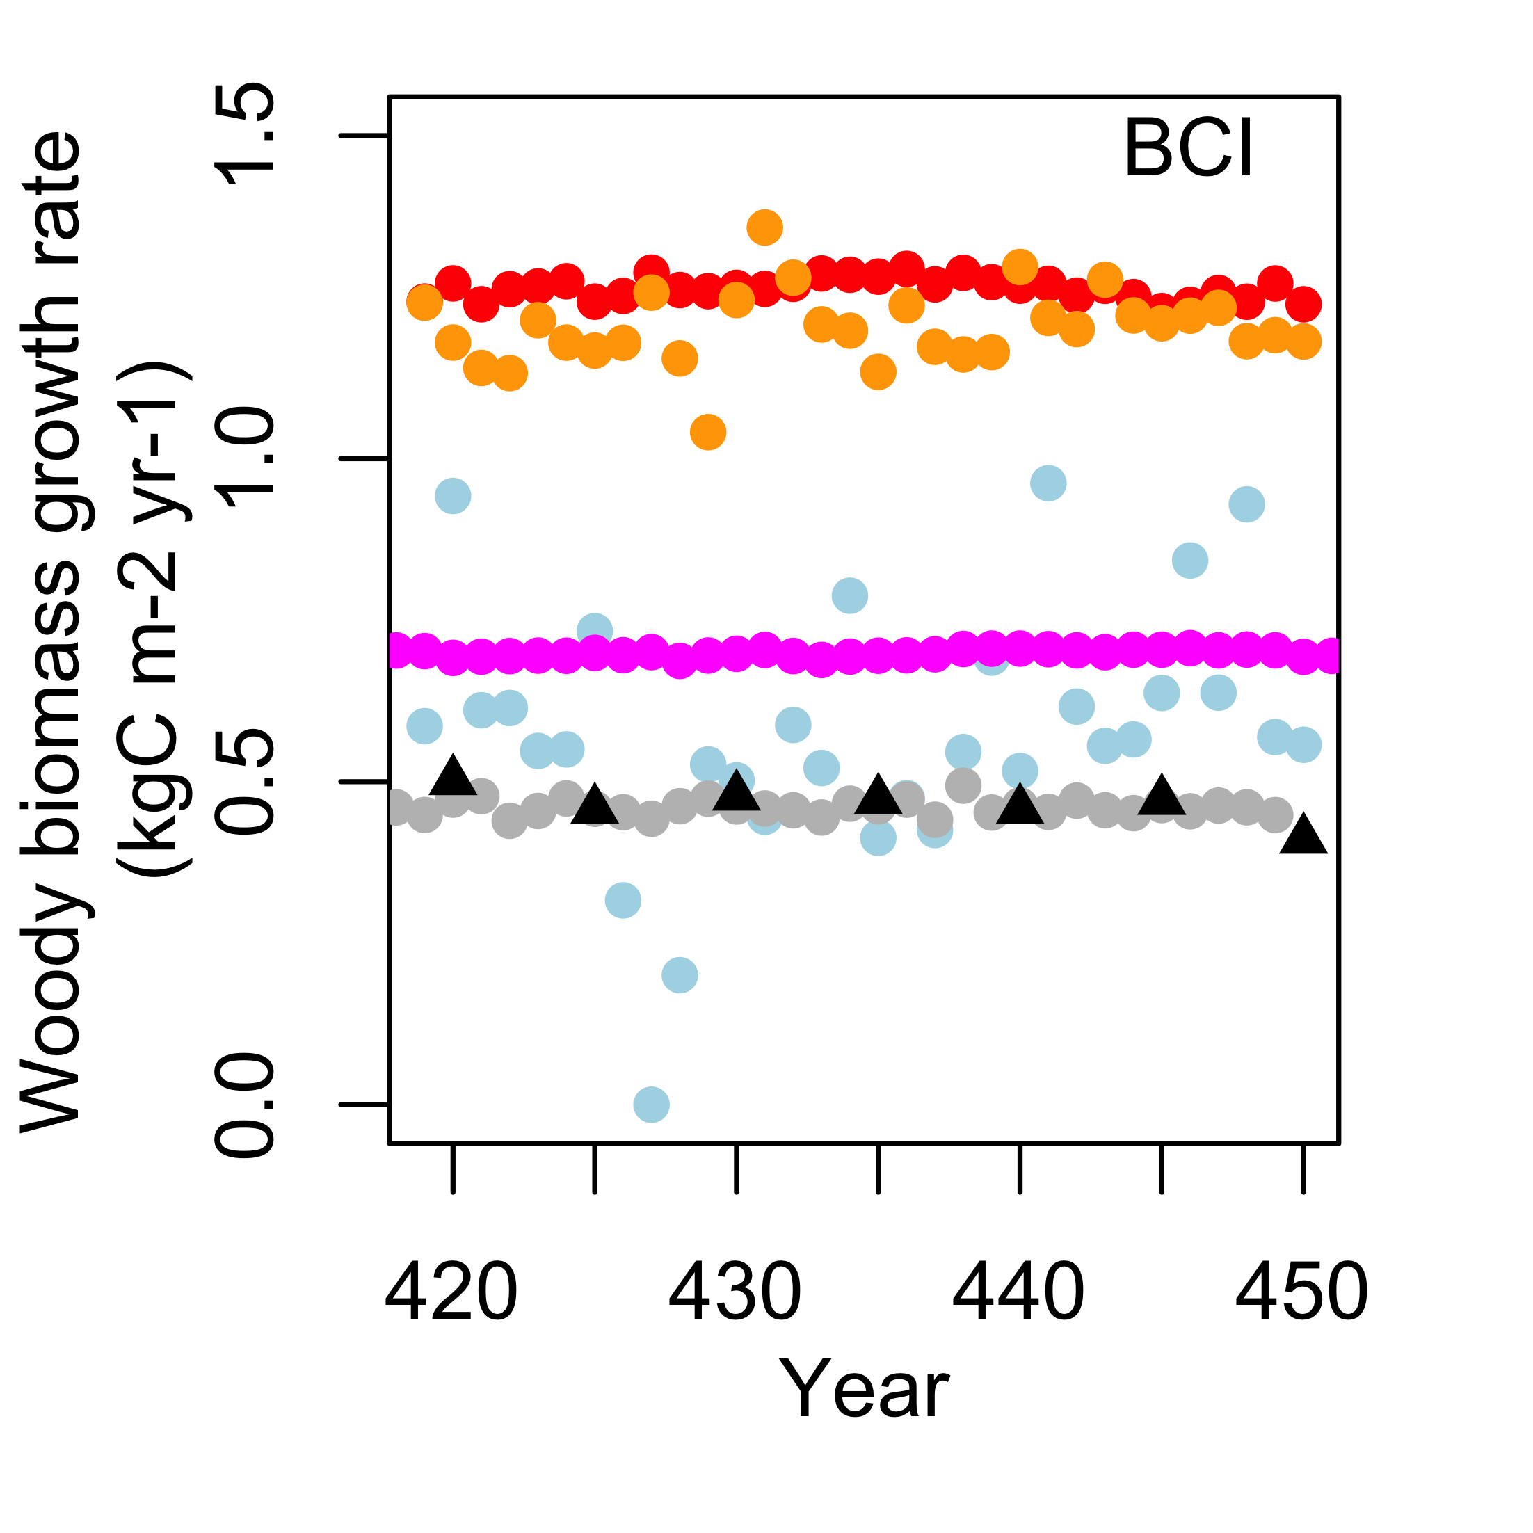
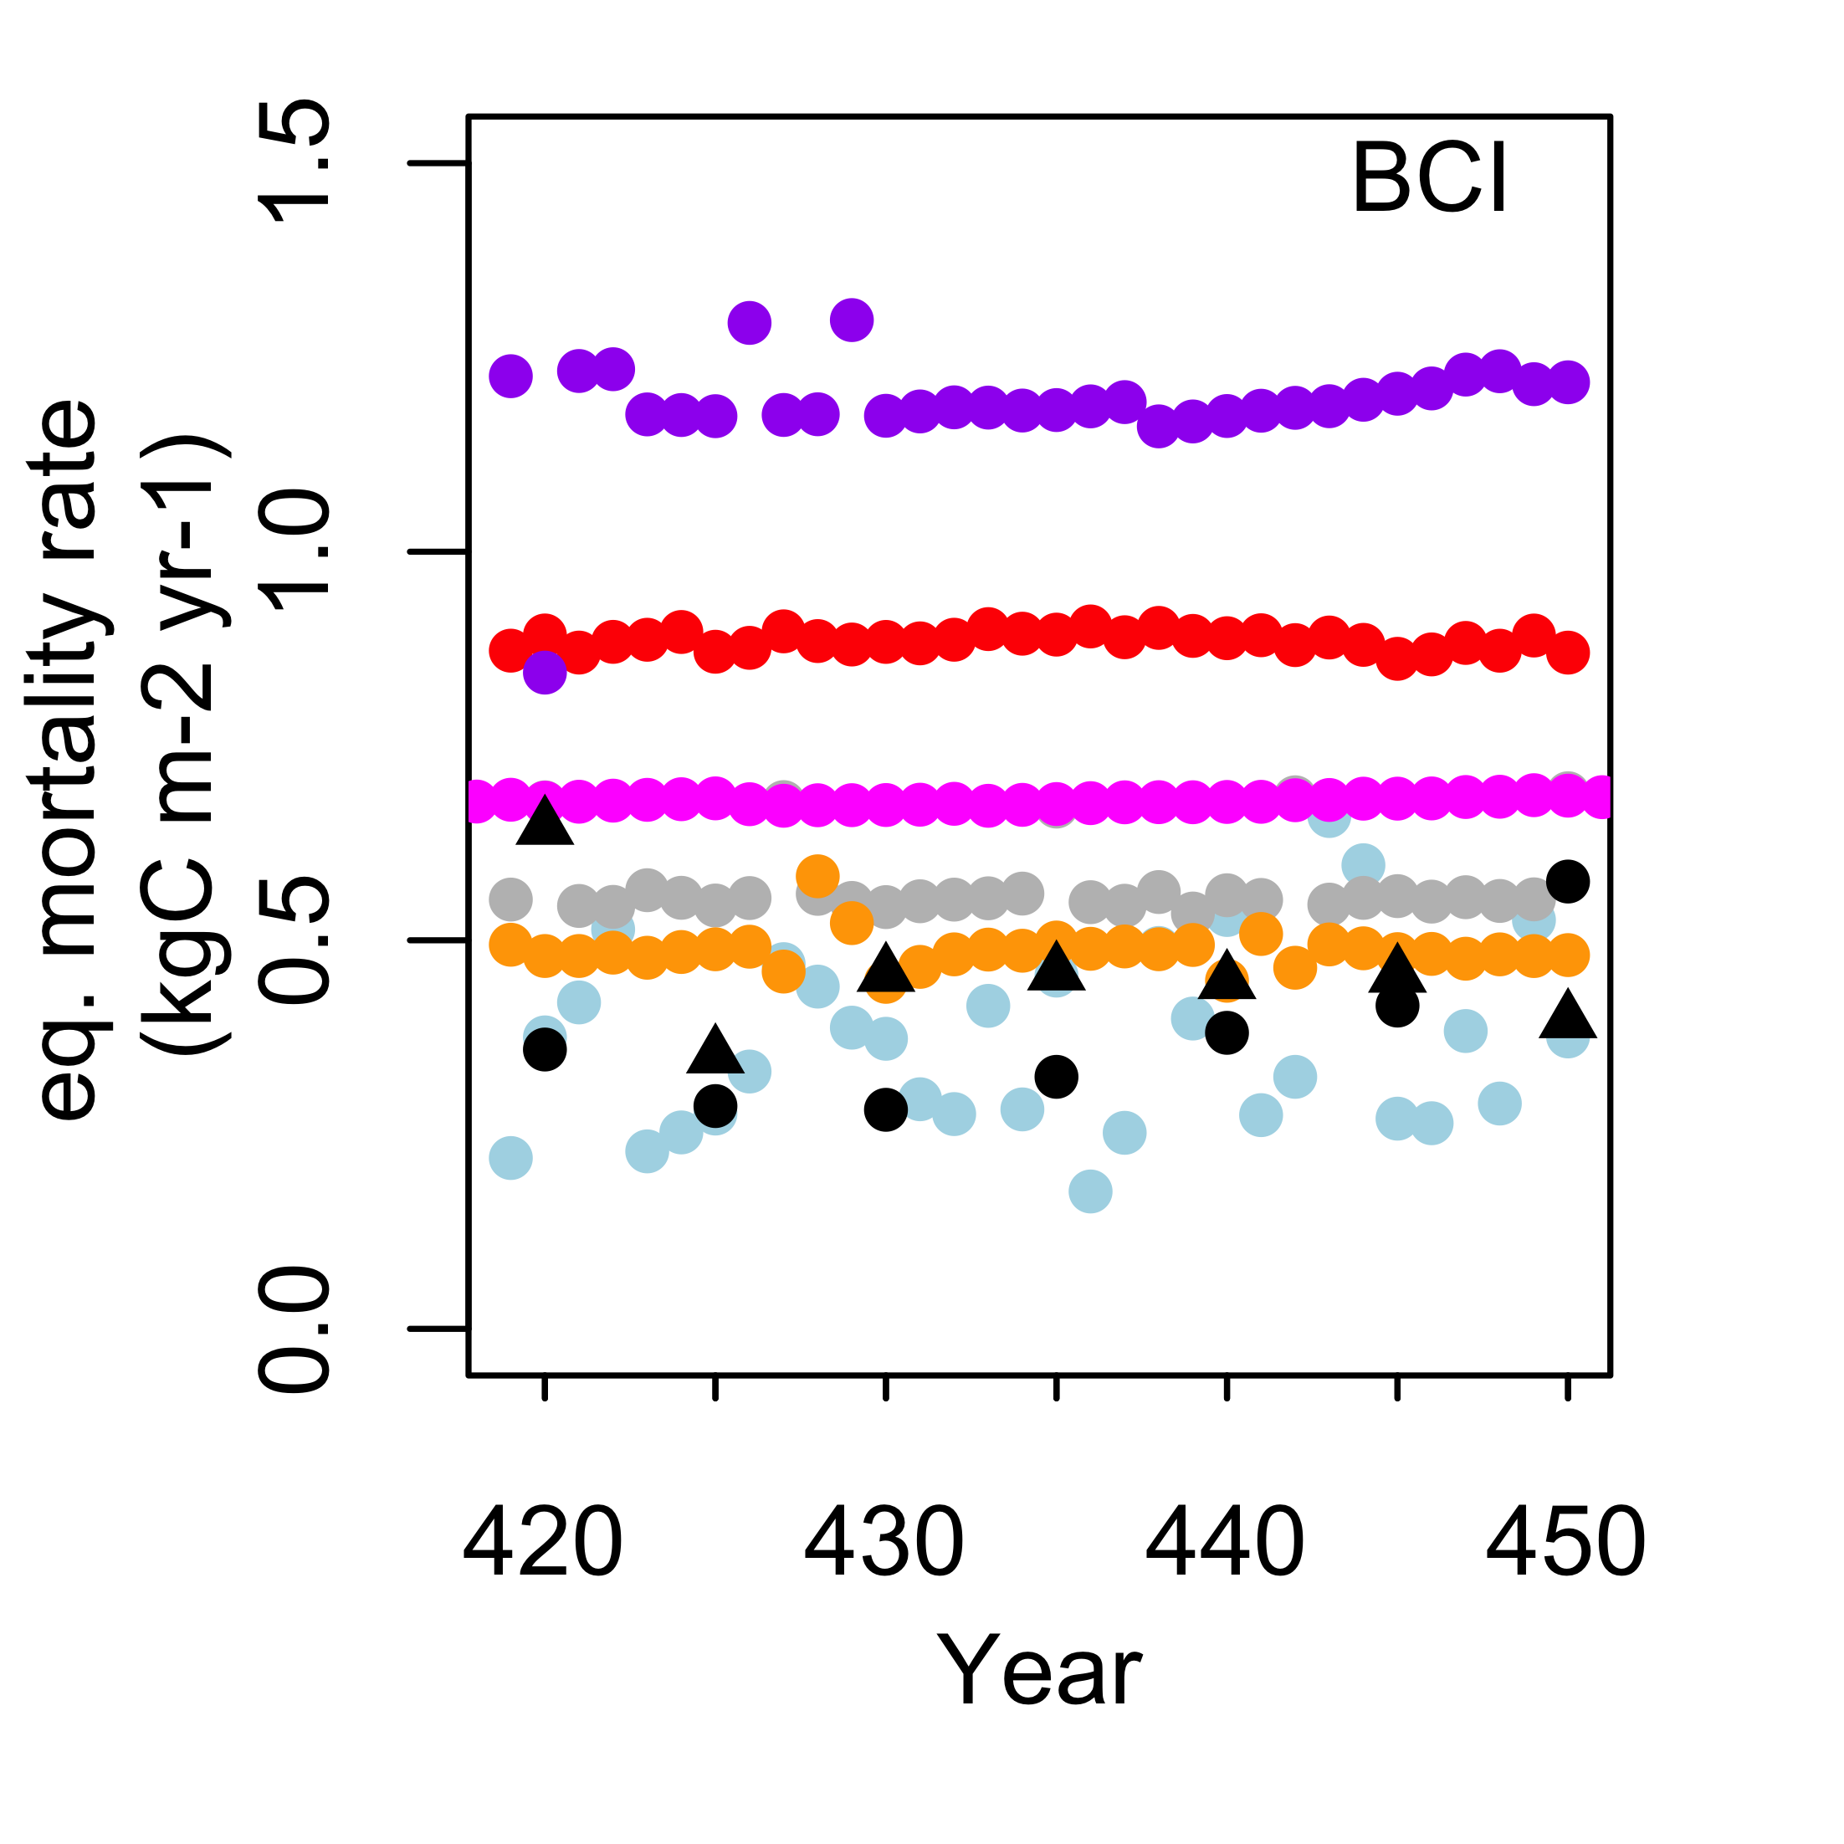
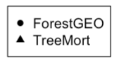
Some models overestimate both observations.
Most models suggest increase in forest biomass (i.e.
woody biomass growth than loss through Mortality (except CABLE-POP))
+ growth
- mortality
Notes:
Is this because I included cmort_res?!
If more forest biomass – how can this be, with dynamic equilibria being relatively constant? I see that LPJ-GUESS makes sense, and Biome E-Standalone, too

Slide 17
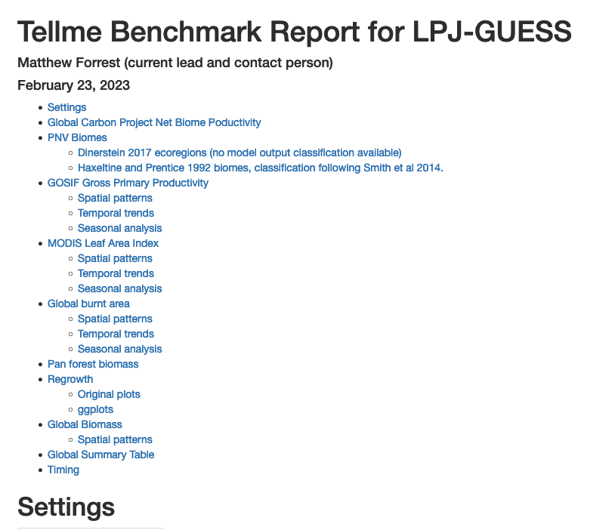
Route forward towards standardized benchmarking
Collected many variables: LAI, Crown area, height, (total or by PFT, by sizeclass), npp, nep, albedo
Seamlessly integrate with TELLUS benchmark
Global bench- marking
Model_name
Notes:
All these models now have or are working on the capability to output biomass and other variables not shown here with an added size-class dimension.
This opens up opportunity for many more studies for benchmarking at that level.
Data will be made available for everyone to conduct further studies on this.
----
We can also answer questions about : What changes – in pft composition, carbon content or albedo - do these models predict under increased disturbances?
Regrowth benchmarks are becoming a part of the TELLUS Benchmarking suite, developed by Matt Forest.
Learning from this exercise and digesting the difficulties:
What Aboveground biomass means for the different models differs between them. What allometric assumptions are made for biomass estimates differ between Tropics and broeal/temperae region ( eg tropics seem to more often omit foliage and concentrate on the woody biomass, whereas equations exist for boreal species and for temperate ( even broadleaf) species, to consider leaves.
”Height” must be very well defined, and ideally with satellite people to be the most meaningful for benchmarking.
--------------------------------------------------------------------------------------------------------------------------------------------------------------------
“We outline the planned route forward towards a standardised international benchmarking framework for demographic DGVMs.” from abstract..

Slide 18
Take-home
Demographic vegetation models show promising performance
provide additional information through more detailed processes-representation for LSMs.
Global Demographic Model Benchmarking underway
Notes:
“Show that demographic models show highly promising performance” for stand structure and regrowth at these sites.
The next step is to take this process forward to a wider dataset and assess geographic variation in woody growth and mortality rates.

Slide 19

















EVERYONE, please add your logo here
TreeMort

Slide 20
References
Datasets:
Boreal:
Regrowth:
Tomppo, E., Heikkinen, J.,Henttonen, H.M., Ihalainen, A., Katila, M., Mäkelä, H.,Tuomainen, T., Vainikainen, N., 2011. Designing andconducting a forest inventory - case: 9th National ForestInventory of Finland, Managing Forest Ecosystems. Springer, Dordrecht.
Equilibrium Dynamics + stand structure:
Peltoniemi, M., & Mäkipää, R. (2011). Quantifying distance-independent tree competition for predicting Norway spruce mortality in unmanaged forests. Forest Ecology and Management, 261(1), 30–42. https://doi.org/10.1016/j.foreco.2010.09.019
Temperate:
Regrowth:
Teobaldelli, M., Somogyi, Z., Migliavacca, M., & Usoltsev, V. A. (2009). Generalized functions of biomass expansion factors for conifers and broadleaved by stand age, growing stock and site index. Forest Ecology and Management, 257(3), 1004–1013. https://doi.org/10.1016/j.foreco.2008.11.002
Equilibrium Dynamics + stand structure:
Brzeziecki, B., Pommerening, A., Miścicki, S., Drozdowski, S., & Żybura, H. (2016). A common lack of demographic equilibrium among tree species in Białowieża National Park (NE Poland): Evidence from long-term plots. Journal of Vegetation Science, 27(3), 460–469. https://doi.org/10.1111/jvs.12369
Tropics:
Regrowth:
Poorter, L., Bongers, F., Aide, T. M., Almeyda Zambrano, A. M., Balvanera, P., Becknell, J. M., Boukili, V., Brancalion, P. H. S., Broadbent, E. N., Chazdon, R. L., Craven, D., de Almeida-Cortez, J. S., Cabral, G. A. L., de Jong, B. H. J., Denslow, J. S., Dent, D. H., DeWalt, S. J., Dupuy, J. M., Durán, S. M., … Rozendaal, D. M. A. (2016). Biomass resilience of Neotropical secondary forests. Nature, 530(7589), Article 7589. https://doi.org/10.1038/nature16512
Equilibrium Dynamics + stand structure:
Condit, Richard et al. (2019), Complete data from the Barro Colorado 50-ha plot: 423617 trees, 35 years, Dryad, Dataset, https://doi.org/10.15146/5xcp-0d46
Davies SJ, Abiem I, Abu Salim K, Aguilar S, Allen D, Alonso A, Anderson- Teixeira K, Andrade A, Arellano G, Ashton PS et al. 2021. ForestGEO: understanding forest diversity and dynamics through a global observatory network. Biological Conservation 253: 108907
Key model references:
LPJ-GUESS
Smith, B., Wårlind, D., Arneth, A., Hickler, T., Leadley, P., Siltberg, J., & Zaehle, S. (2014). Implications of incorporating N cycling and N limitations on primary production in an individual-based dynamic vegetation model. Biogeosciences, 11(7), 2027–2054. https://doi.org/10.5194/bg-11-2027-2014
Smith, B., Prentice, I.C. & Sykes, M.T. 2001. Representation of vegetation dynamics in the modelling of terrestrial ecosystems: comparing two contrasting approaches within European climate space. Global Ecology & Biogeography 10: 621-637.
Lindeskog, M., Arneth, A., Bondeau, A., Waha, K., Seaquist, J., Olin, S. & Smith, B. 2013. Implications of accounting for land use in simulations of ecosystem services and carbon cycling in Africa. Earth System Dynamics 4: 385-407.
BiomeES (BiomeE-Standalone)
Weng, E., Aleinov, I., Singh, R., Puma, M. J., McDermid, S. S., Kiang, N. Y., Kelley, M., Wilcox, K., Dybzinski, R., Farrior, C. E., Pacala, S. W., & Cook, B. I. (2022). Modeling demographic-driven vegetation dynamics and ecosystem biogeochemical cycling in NASA GISS’s Earth system model (ModelE-BiomeE v.1.0). Geoscientific Model Development, 15(22), 8153–8180. https://doi.org/10.5194/gmd-15-8153-2022
BiomeEP ( BiomeE P-model coupled)
Stocker, B. D., Wang, H., Smith, N. G., Harrison, S. P., Keenan, T. F., Sandoval, D., Davis, T., & Prentice, I. C. (2020). P-model v1.0: An optimality-based light use efficiency model for simulating ecosystem gross primary production. Geoscientific Model Development, 13(3), 1545–1581. https://doi.org/10.5194/gmd-13-1545-2020
FATES
JULES-RED
Argles, A. P. K., Moore, J. R., Huntingford, C., Wiltshire, A. J., Harper, A. B., Jones, C. D., & Cox, P. M. (2020). Robust Ecosystem Demography (RED version 1.0): A parsimonious approach to modelling vegetation dynamics in Earth system models. Geoscientific Model Development, 13(9), 4067–4089. https://doi.org/10.5194/gmd-13-4067-2020
ORCHIDEE
Krinner, G., Viovy, N., de Noblet-Ducoudré, N., Ogée, J., Polcher, J., Friedlingstein, P., Ciais, P., Sitch, S., & Prentice, I. C. (2005). A dynamic global vegetation model for studies of the coupled atmosphere-biosphere system. Global Biogeochemical Cycles, 19(1). https://doi.org/10.1029/2003GB002199
Naudts, K., Ryder, J., McGrath, M. J., Otto, J., Chen, Y., Valade, A., Bellasen, V., Berhongaray, G., Bönisch, G., Campioli, M., Ghattas, J., De Groote, T., Haverd, V., Kattge, J., MacBean, N., Maignan, F., Merilä, P., Penuelas, J., Peylin, P., … Luyssaert, S. (2015). A vertically discretised canopy description for ORCHIDEE (SVN r2290) and the modifications to the energy, water and carbon fluxes. Geoscientific Model Development, 8(7), 2035–2065. https://doi.org/10.5194/gmd-8-2035-2015
Vuichard, N., Messina, P., Luyssaert, S., Guenet, B., Zaehle, S., Ghattas, J., Bastrikov, V., & Peylin, P. (2019). Accounting for carbon and nitrogen interactions in the global terrestrial ecosystem model ORCHIDEE (trunk version, rev 4999): Multi-scale evaluation of gross primary production. Geoscientific Model Development, 12(11), 4751–4779. https://doi.org/10.5194/gmd-12-4751-2019
CABLE-POP

